Slide 1
Virtual DOM in React

Slide 2
Agenda
In this session, we will discuss:
Introduction to Virtual DOM
Actual DOM vs. Virtual DOM
Virtual DOM Process
Example of Virtual DOM

Slide 3
Introduction to Virtual DOM
The Virtual DOM is a concept in React that allows efficient updates and rendering of components.
When a component's state changes, React uses the Virtual DOM to determine the minimal necessary changes to the actual DOM and update only those elements.
This approach is faster than making direct changes to the DOM because it reduces the number of required operations.
Notes:
It serves as a bridge between the component's state and the actual DOM, giving a current abstract representation of the state of the component.
When a component's state changes, React determines how little changes to make to the actual DOM are necessary using the Virtual DOM, and then updates only the elements that have changed.
This approach is faster than making changes directly to the actual DOM because it limits the number of DOM operations that are required.

Slide 4
Actual DOM vs. Virtual DOM
Actual DOM:
The actual DOM is the real-time representation of the HTML structure that is created by the browser when it loads a web page.
The actual DOM can be slow to update and computationally expensive, especially when dealing with complex web applications.
Manipulating the actual DOM can be complex and error-prone, as it requires directly interacting with the low-level HTML and CSS code of the page.

Slide 5
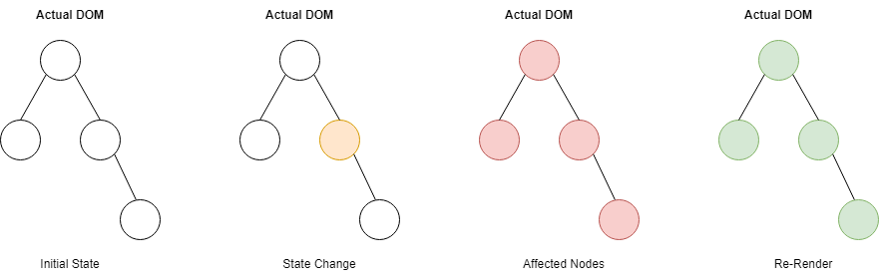
Actual DOM vs. Virtual DOM
Actual DOM:

Slide 6
Actual DOM vs. Virtual DOM
Virtual DOM:
The virtual DOM is an abstraction of the actual DOM that exists in memory.
The virtual DOM is a lightweight copy of the actual DOM that can be modified and updated without affecting the actual DOM until necessary.
The virtual DOM is used in some frameworks like React to optimize the process of updating the actual DOM.
Virtual DOM enables an application to have efficient and faster user interfaces.

Slide 7
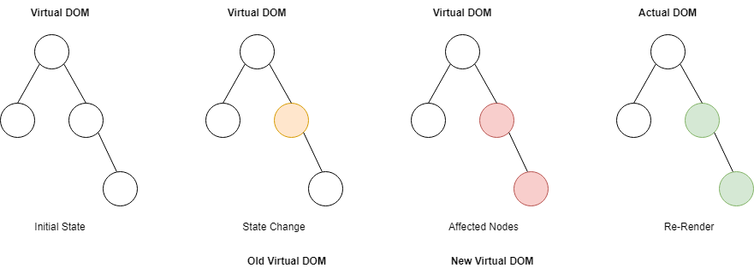
Actual DOM vs. Virtual DOM
Virtual DOM:

Slide 8
Virtual DOM Process
Notes:
Here's how the process works:
React renders a component and creates a Virtual DOM representation of it.
When the component's state changes, React creates a new Virtual DOM representation.
React then determines the smallest set of changes that need to be made to the actual DOM by comparing the old and new Virtual DOM representations.
React then updates the actual DOM with the changes, only updating the elements that have changed.

Slide 9
Example of Virtual DOM
To be demonstrated in VSCode
Go to "React Recording Content\week1-app\week1-app\src\components\03_Virtual DOM in React\Example of Virtual DOM" to explain the concept of Virtual DOM.

Slide 10
Summary
Here’s a brief recap:
The Virtual DOM is a lightweight in-memory representation of the actual DOM used by React to optimize UI updates.
React compares the Virtual DOM with the actual DOM, identifies changes, and efficiently updates only the necessary parts of the real DOM.
When a component state changes, React updates the Virtual DOM, compares it with the previous version, and applies only the difference to the real DOM.

